Slide 1
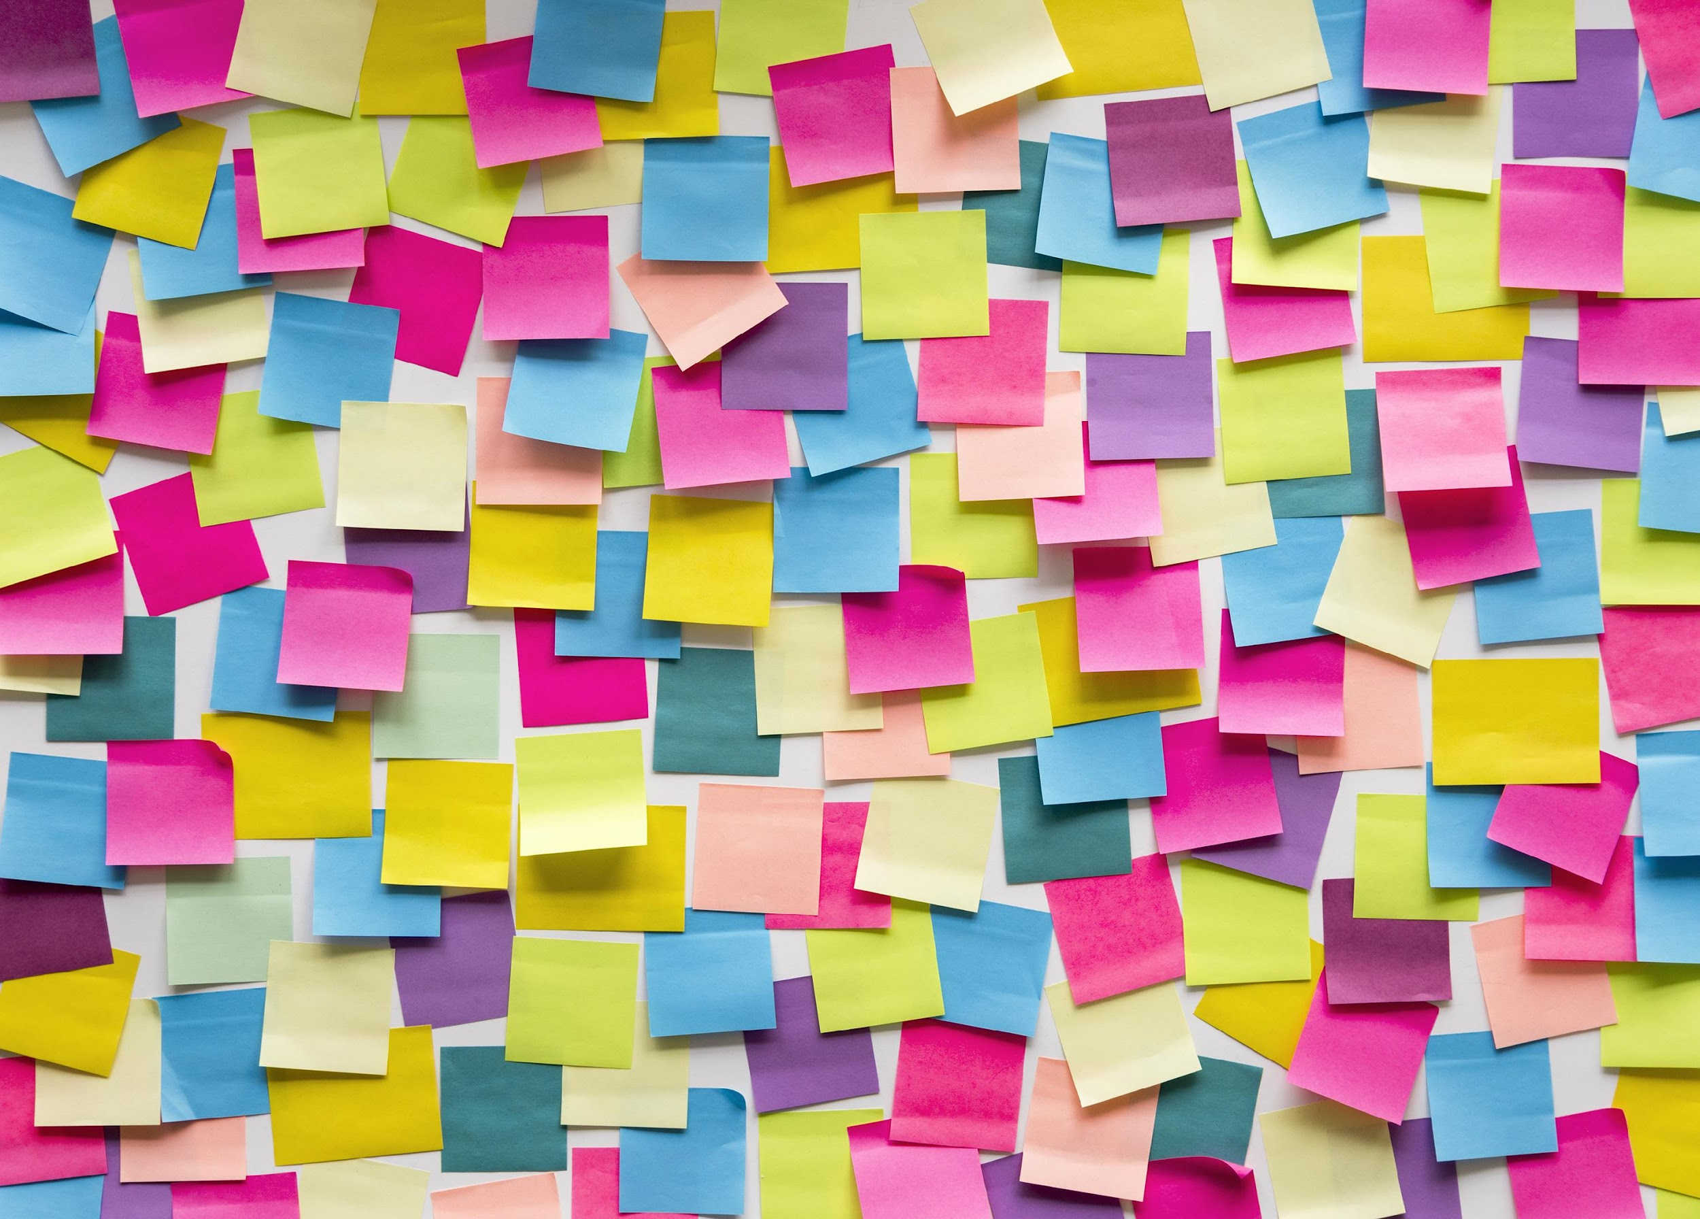






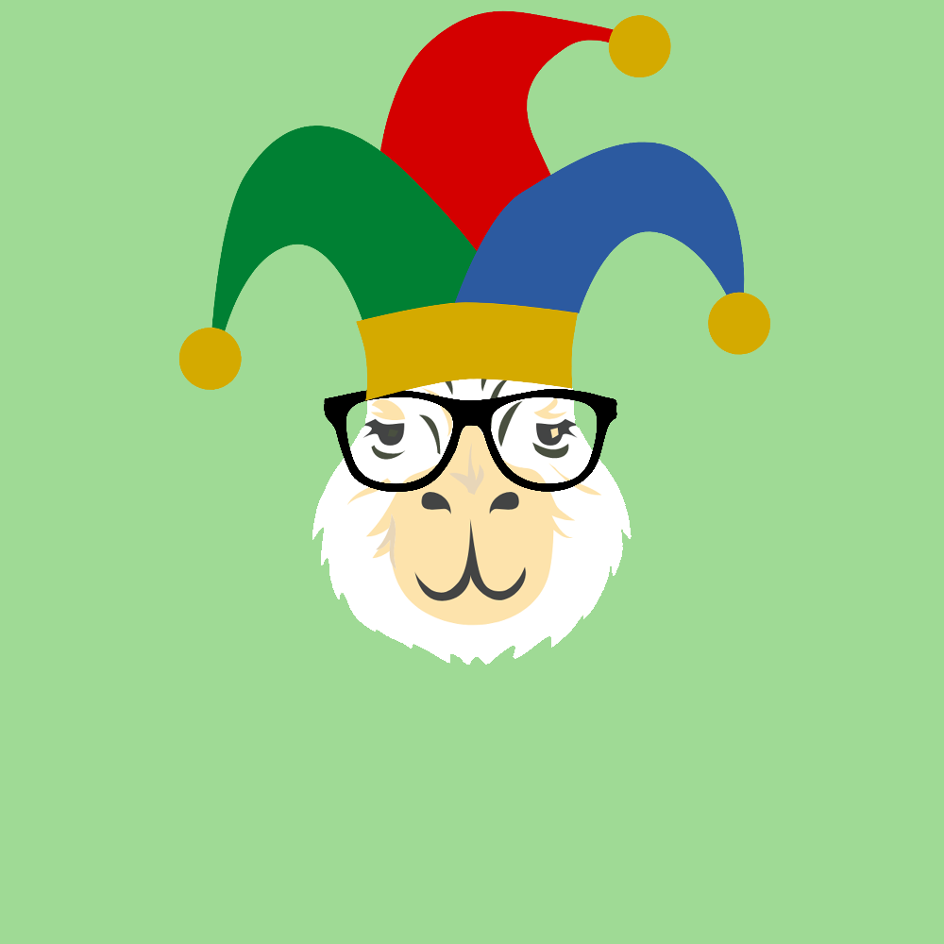

NFTs
And Our Journey To The Creation Of The Cryptobara Collection
A project by: Marcela Castano Rina Weiner Frank Lau Monique Ferguson

Slide 2
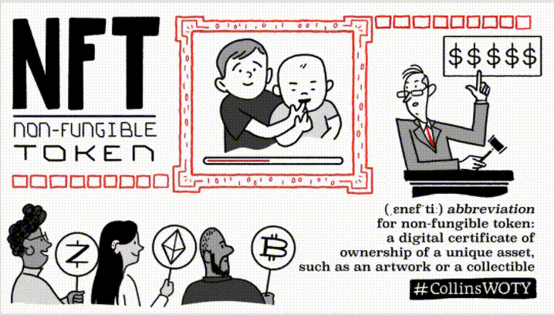

Wait, what’s an NFT?
Did you know that NFT was Collins Dictionary Word of the Year 2021?

Slide 3
Importance of NFTs
From the art world to significant businesses and even high-profile celebrity products, NFT technology is slated to change the nature of digital ownership permanently.
However, behind the hype of owning digital items is a much bigger and more important picture. NFTs are on the verge of totally revolutionizing finance trade and global commerce.
There is the potential to tokenize a wide range of assets and connect the finance world to decentralized finance (DeFi) markets.
Financial trade instruments, such as fixed income products and investment notes, can securely move along the blockchain in a way that brings transparency, promotes seamless settlement, and grow liquidity.
Also, smart contracts eliminate intermediaries, diminish counterparty risk and maintain the integrity of deliverables.

Slide 4
Importance of NFTs
NFTs are more than just pngs and jpegs on a blockchain — they represent digital ownership.
They are constructed upon smart contracts and blockchain technology, the same decentralized networks that command many popular cryptocurrencies.
Blockchain platforms are highly secure and offer entirely verifiable data and an immutable ledger history.
Smart contracts, meanwhile, are self-executing, predetermined transactions that reside on the blockchain and define how the assets on the blockchain work.
NFTs can take any information and give it a form of uniqueness by making it cryptographically unique from any other batch of data.
The data encoded into an NFT cannot be changed, counterfeited, or in any way accessed by anyone not in possession of the pertinent cryptographic keys.

Slide 5
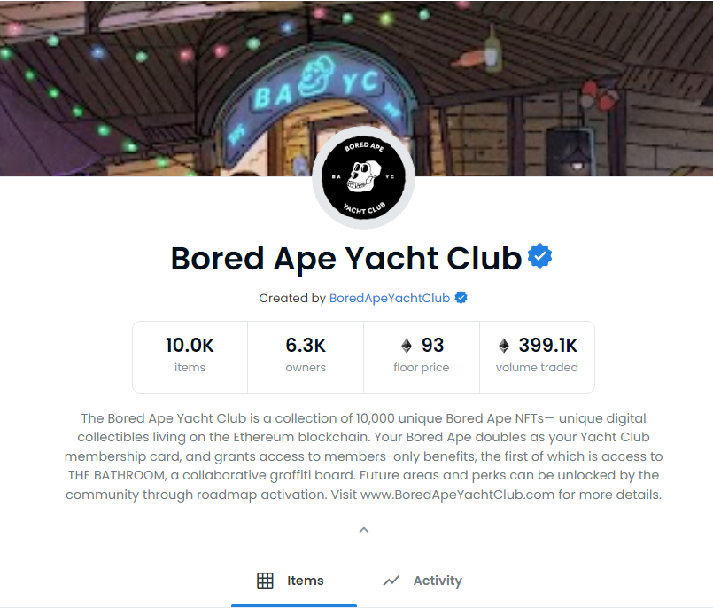
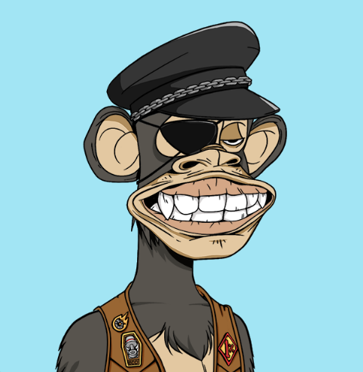
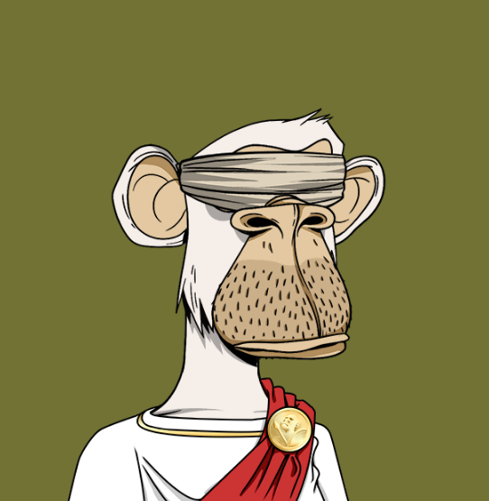
Example NFT Collection

Slide 6
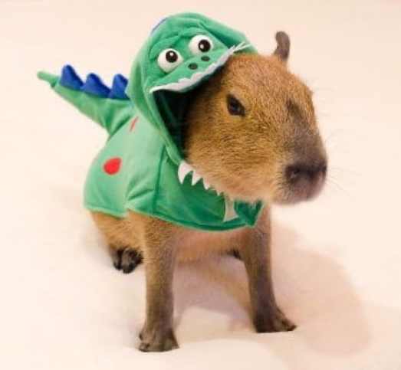
The Project

Slide 7
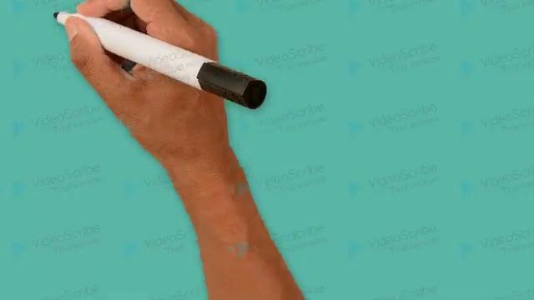
Our Process!

Slide 8
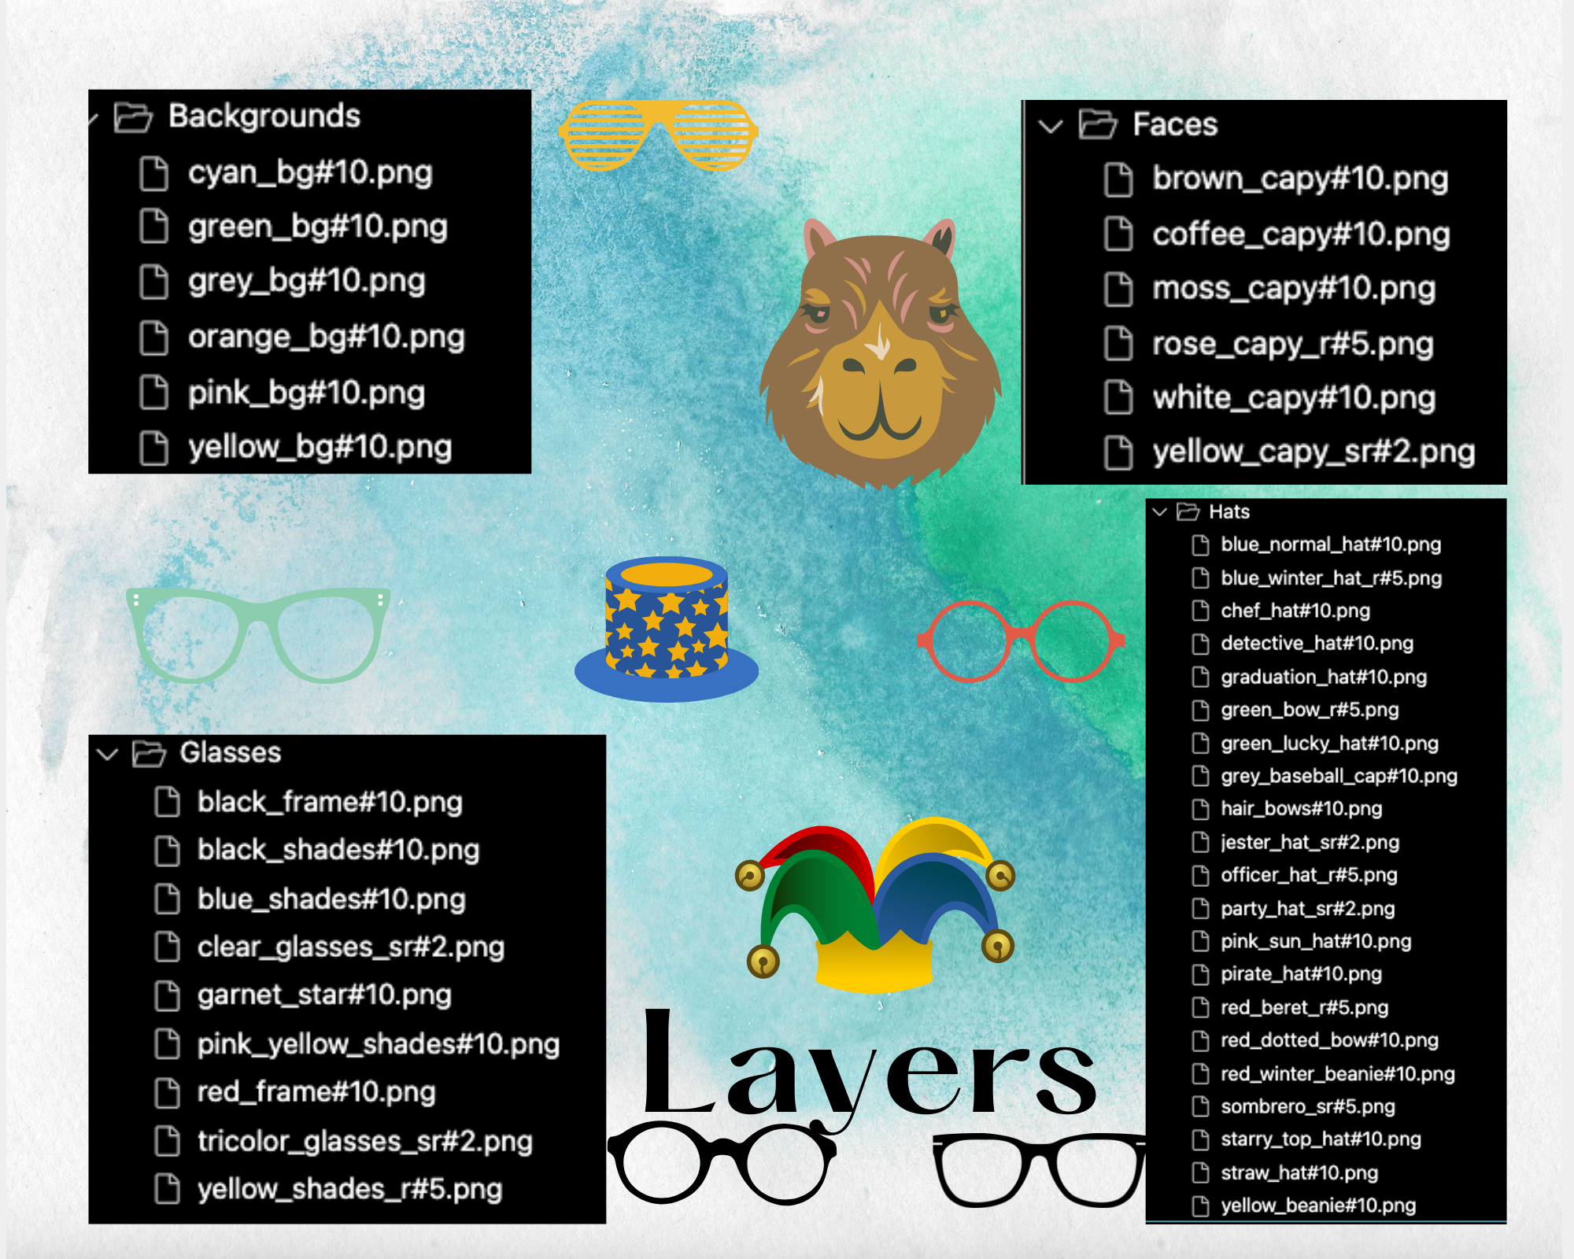
Creation of Layers

Slide 9
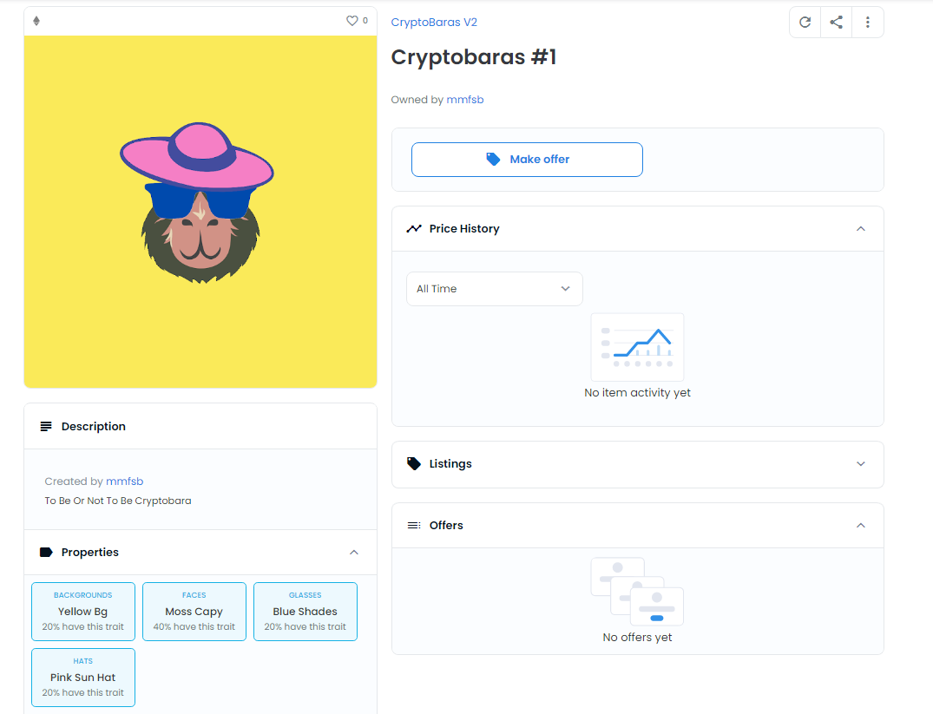
Rarity Properties on OpenSea

Slide 10
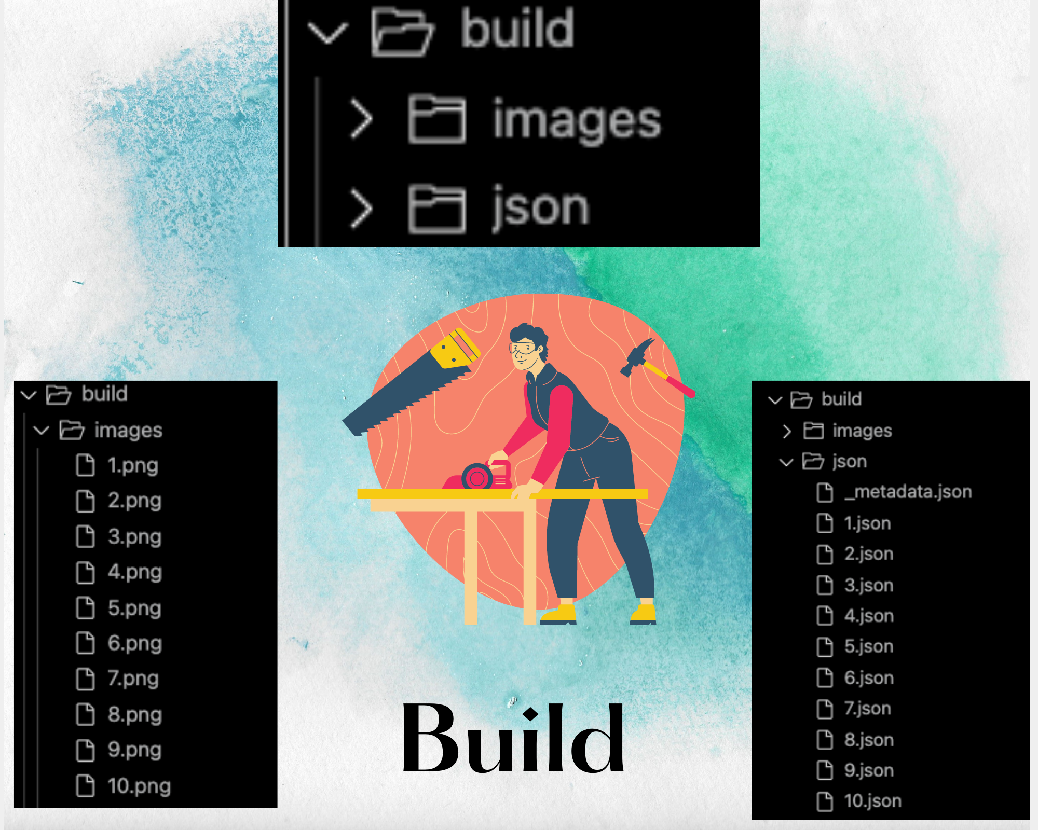
Build of Images and Json

Slide 11

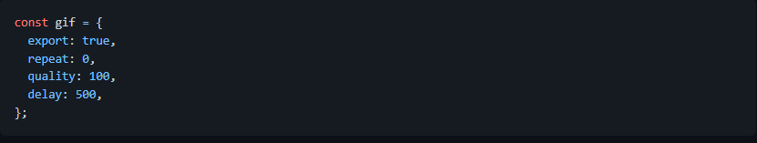
Preview Images

Slide 12

Pixelated Images

Slide 13
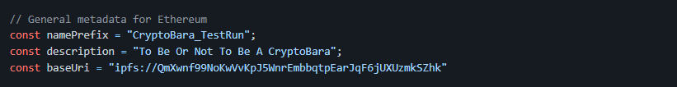
MetaData Info
Metadata is an essential part of what makes an NFT. It contains all the image’s primary information.

Slide 14
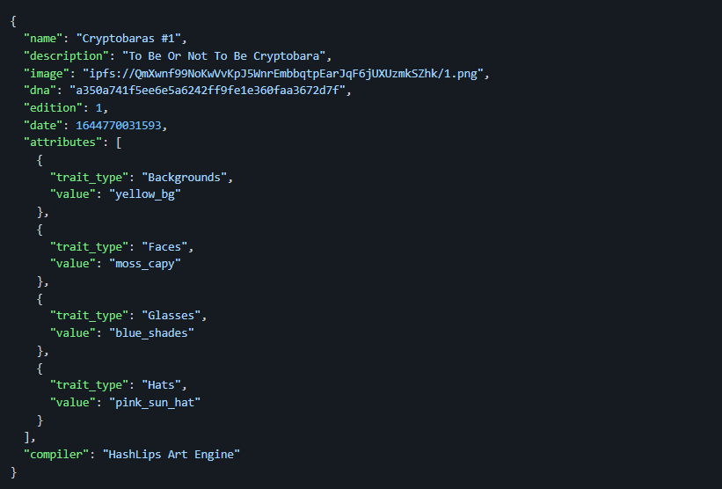
MetaData of one image

Slide 15
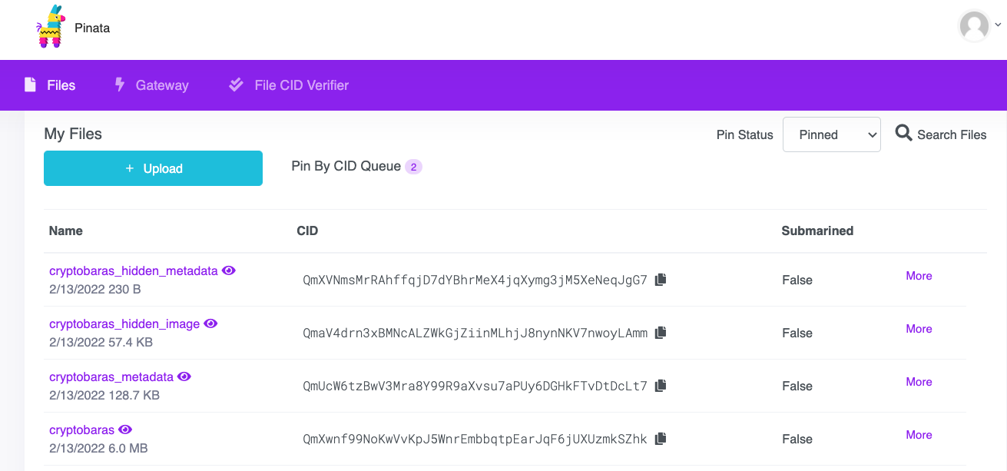
Pinata and IPFS

Slide 16

Smart Contract

Slide 17
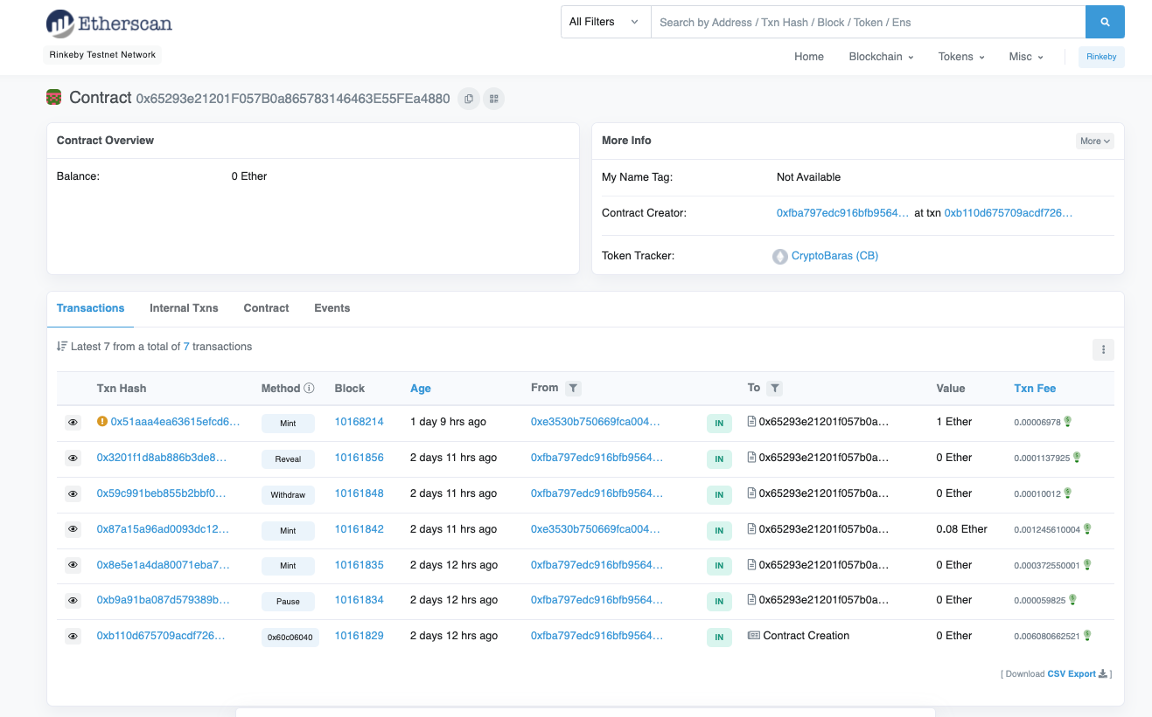
Contract on Rinkeby Testnet Network

Slide 18
Dapp on Streamlit

Slide 19
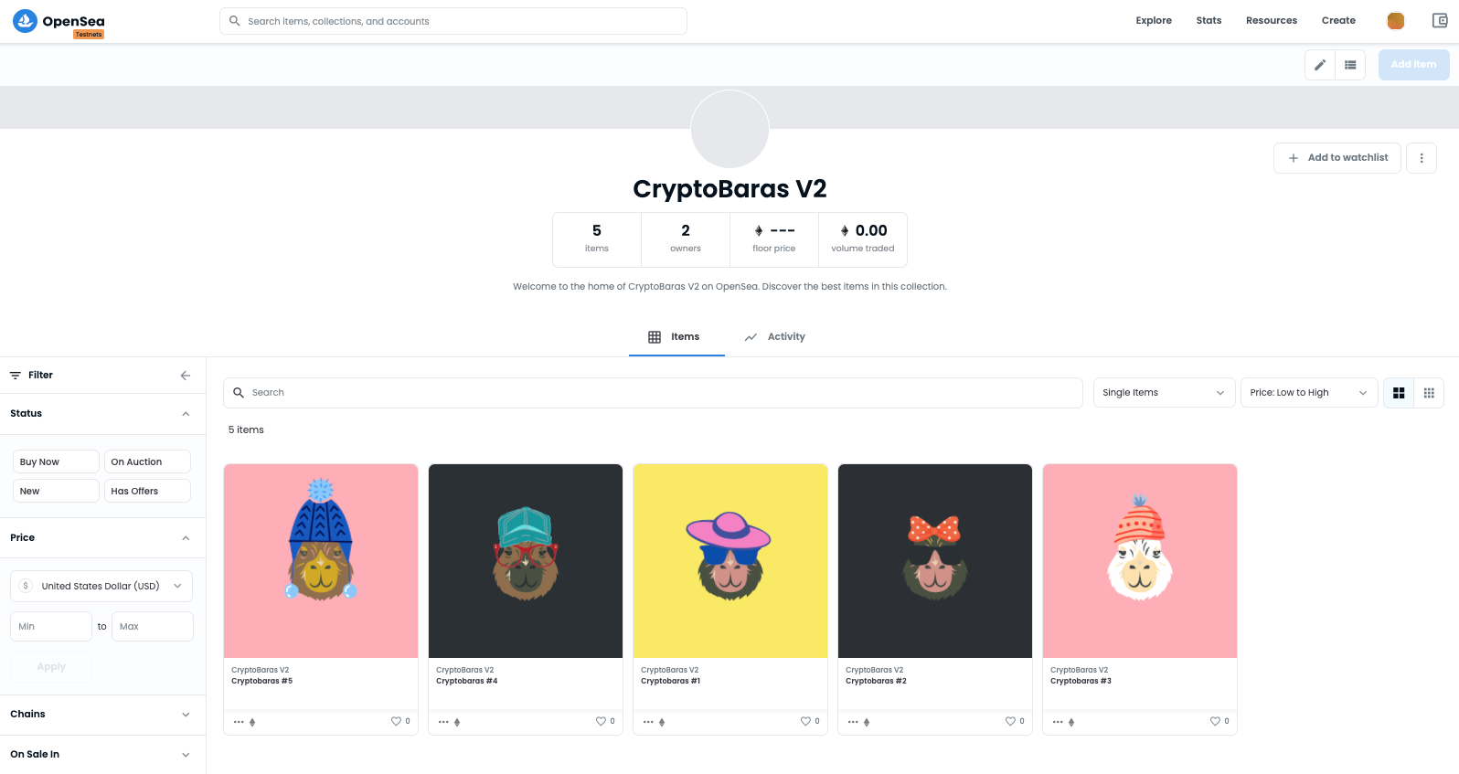
Minted Collection on OpenSea Testnet

Slide 20
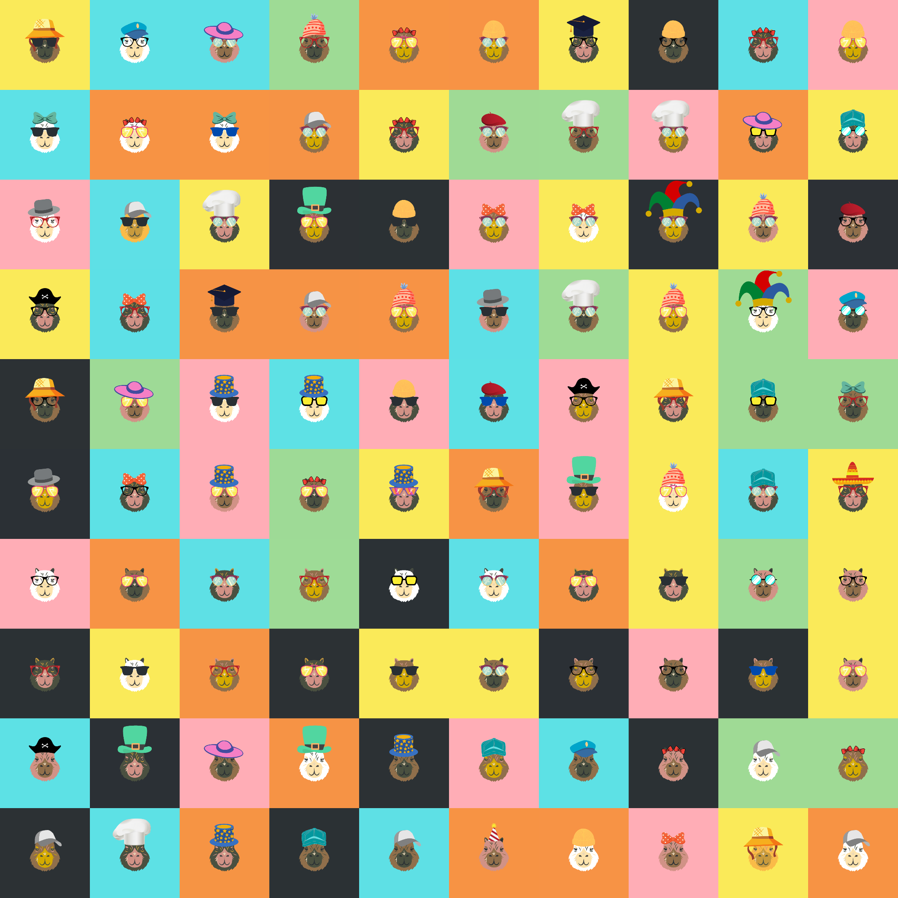
The Cryptobara
Collection

Slide 21
Explain how this project relates to fintech
Liability NFTs and Asset NFTs are created to authenticate proprietary rights of a given contract for the promisor (the party who makes a promise) and the promisee (the party receives the benefits of a contract). Thus contract agreements are tokenized with Liability NFTs and Asset NFTs.
This creates new possibilities for handling sensitive data for businesses and trade finance. It provides a tool for devising new products, IDs, supply chain dynamics, payment handling, and much more.
NFTs can create a blockchain “receipt” that can track a product from its beginning to when it reaches the consumer. Every step to its creation and everyone who handles the product would be recorded and cannot be changed.
Trade Finance consists of intricate regulatory and supply chain processes. These procedures involve numerous moving parts and require a great deal of trust, and thus are highly susceptible to document fraud.
NFTs can remove those barriers, eliminate fraud and decrease reliance on intermediaries by tokenizing assets and documents into a single unchangeable digital token.
It will minimize the rate of prohibited activity in trade finance, but it also means that companies can save money on overhead, wages, and human error.

Slide 22

Discuss any unanticipated insights or problems that arose and how you resolved them
Initially, we were going to use the Polygon blockchain. We added the polygon mainnet to Metamask and bought some Matic on Coinbase. However, transferring Matic from coinbase to the metamask wallet deposits it into the ethereum mainnet. Bridging Matic to the Polygon Mainnet incurs large gas fees
This can be resolved using https://pancakeswap.finance/

Slide 23
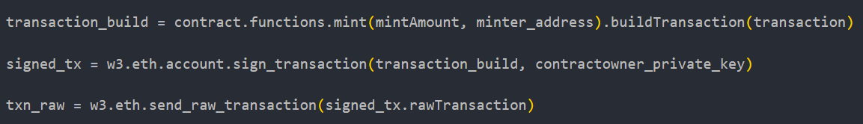
Discuss any unanticipated insights or problems that arose and how you resolved them
Minting transactions inside DApp
Error for extra length data ~ related to .transact method
Solved through following process:
Build Transaction → Sign Transaction → Send Raw Transaction
Error for intrinsic gas too low
Set gas to the same amount as the <gas limit> field on remix

Slide 24
Additional ideas that we’d explore if we had more time.
Art
Design our own art layers and elements (increase variations)
Collaborate with artists over the internet
Deploy to Opensea Mainnet
Contract
Decrease gas fees
Create our own marketplace
Develop our own cryptocoin and link it towards purchasing our NFT (e.g. Shibaswap)
Community
Start a discord chat for The CryptoBaras
Carry out Pre-Sale for NFT collection
Link NFT proceeds with non-profits or specific communities

Slide 25
Works Cited
& Acknowledgments
Simon Kingaby https://github.com/simonkingaby
Art Layers from https://www.canva.com/
Hashlips https://youtu.be/fzH7Gjadmj0

